Slide 1
Post Processing Recommender Systems with Knowledge Graphs for Recency, Popularity, and Diversity of Explanations
Dataset & Paper Analysis
Runtime_Terror_NSU
Md. Baker
Kazi Kaarima Nashia
Fatema Akter Rimi

Slide 2
Contributions:
Define three novel explanation quality metrics to measure (a) the recency of the past linking interaction, (b) the popularity of the shared entity, (c) and the diversity of the explanation types in a recommended list.
Linking Interaction Recency
Shared Entity Popularity (SEP).
Linking Interaction Recency (LIR)
Propose a suite of re-ranking approaches acting on both the original recommended lists and the explainable paths, optimizing for the proposed explanation metrics.
Evaluate our re-ranking approaches on recommendation utility and explanation metrics, considering both the entire user base and individual demographic groups, on two real world public data sets, against seven baselines.
Post Processing Recommender Systems with Knowledge Graphs for Recency, Popularity, and Diversity of Explanations
Paper link: https://paperswithcode.com/paper/post-processing-recommender-systems-with
Dataset link: https://files.grouplens.org/datasets/movielens/ml-latest.zip

Slide 3
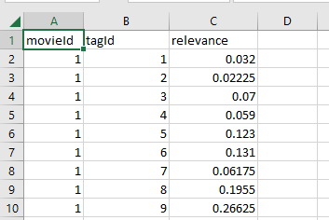
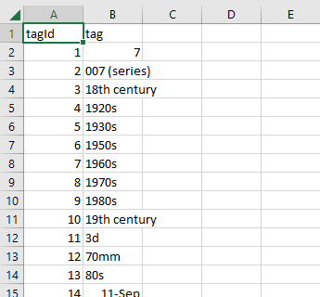
Datasets:
The data are contained in the files `genome-scores.csv`, `genome-tags.csv`, `links.csv`, `movies.csv`, `ratings.csv` and `tags.csv`.
About Dataset: https://files.grouplens.org/datasets/movielens/ml-latest-README.html
genome-scores.csv
genome-tags.csv

Slide 4
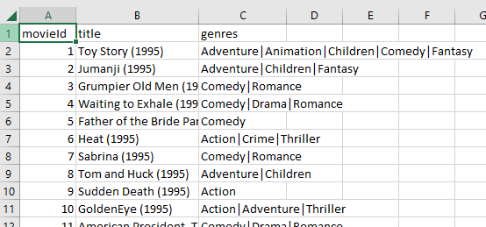
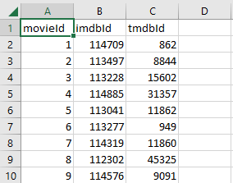
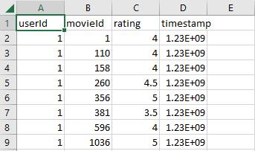
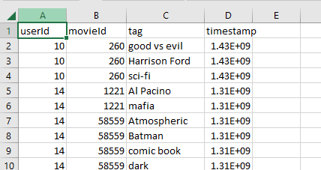
movies.csv
links.csv
ratings.csv
tags.csv

Slide 5
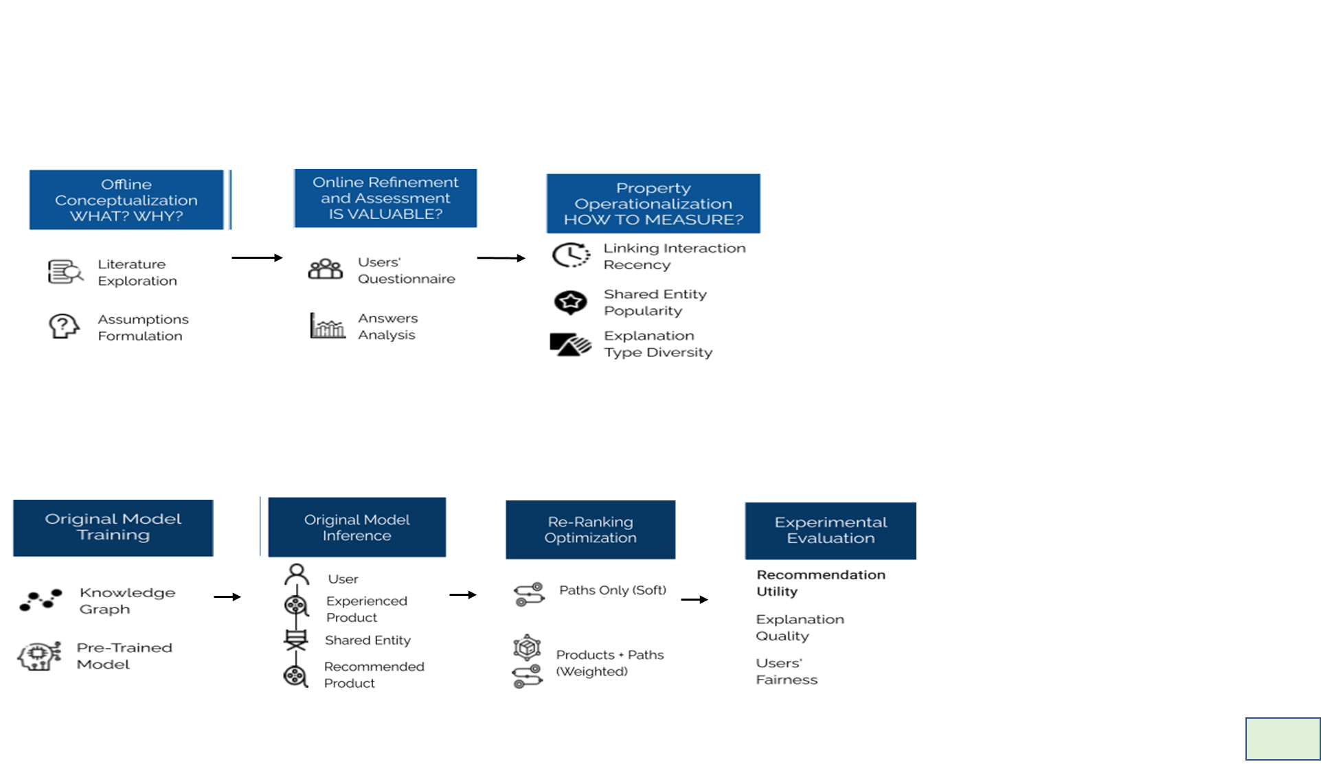

Slide 6
Name of models
Matrix factorization models :FM, NFM, BPR
Explainable recommendation models based on regularization terms :CFKG,CKE, KGAT
Explainable recommendation models based on explanation paths: PGPR,R-PGPR, P-PGPR, D-PGPR, DP-PGPR, PR-PGPR, DR-PGPR, DPR-PGPR

Slide 7
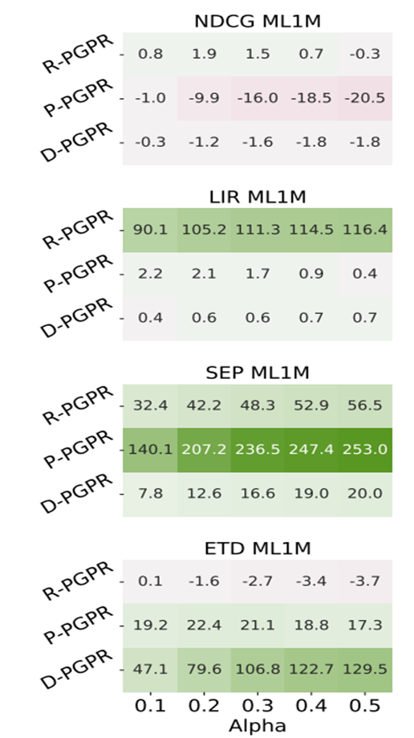

Results
Gain and loss of re-ranking approaches with respect to the original model in terms of recommendation utility and explanation quality

Slide 8
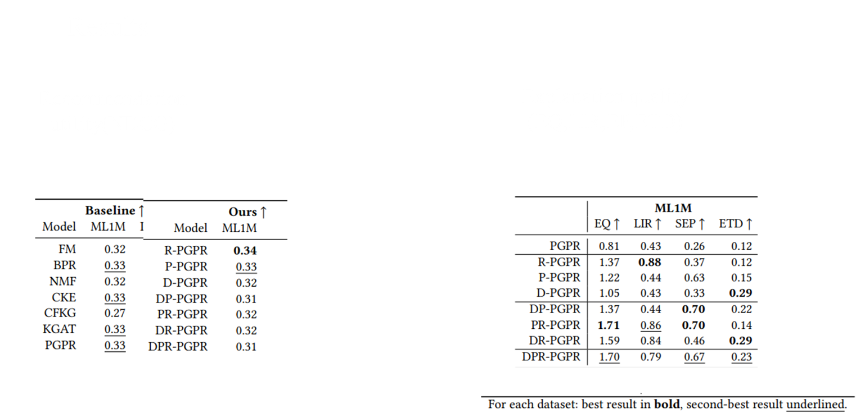

Slide 9
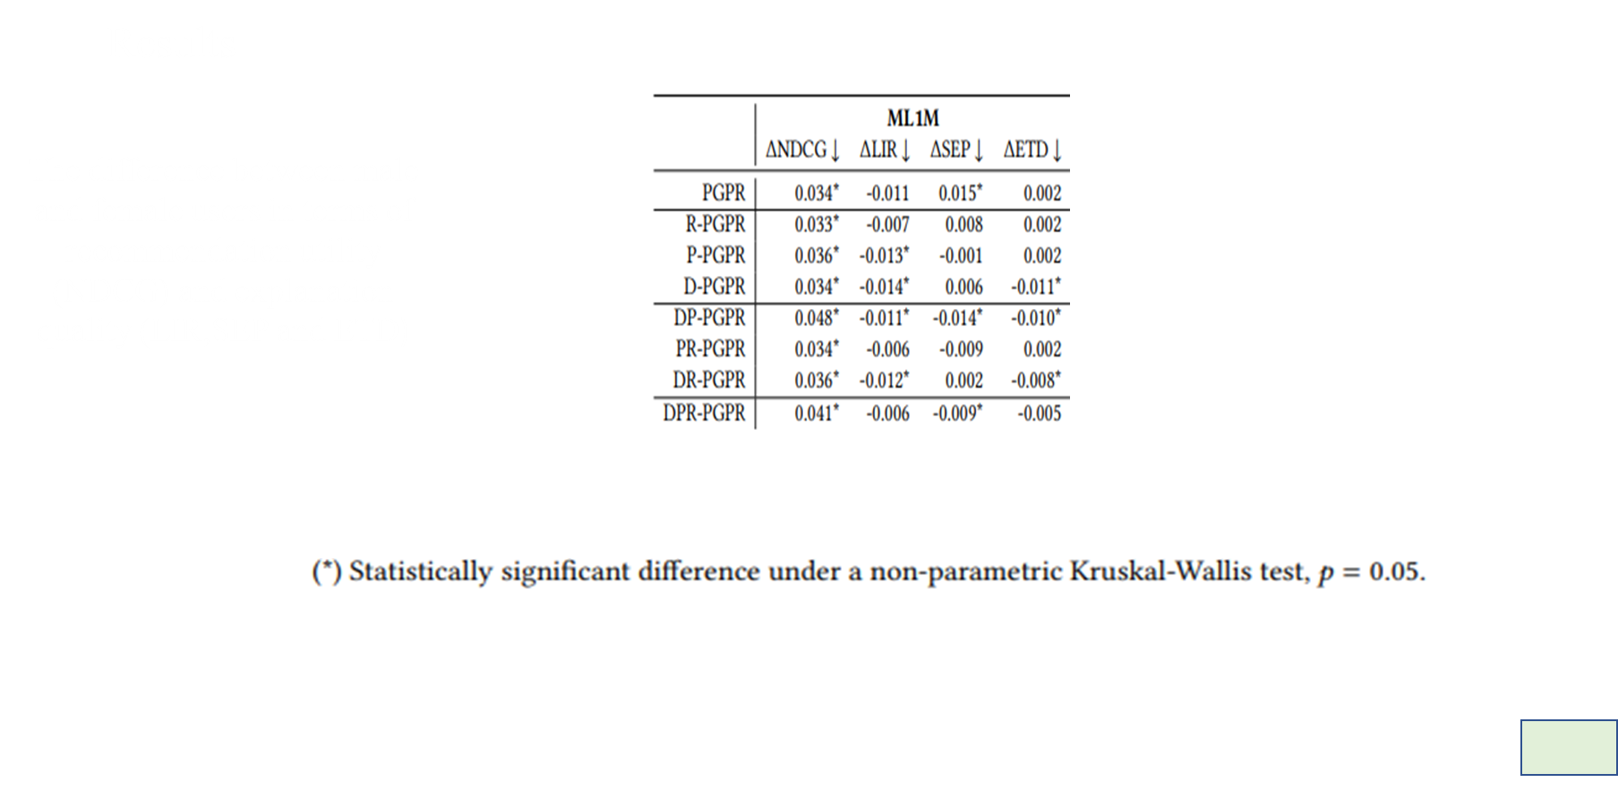

Slide 10
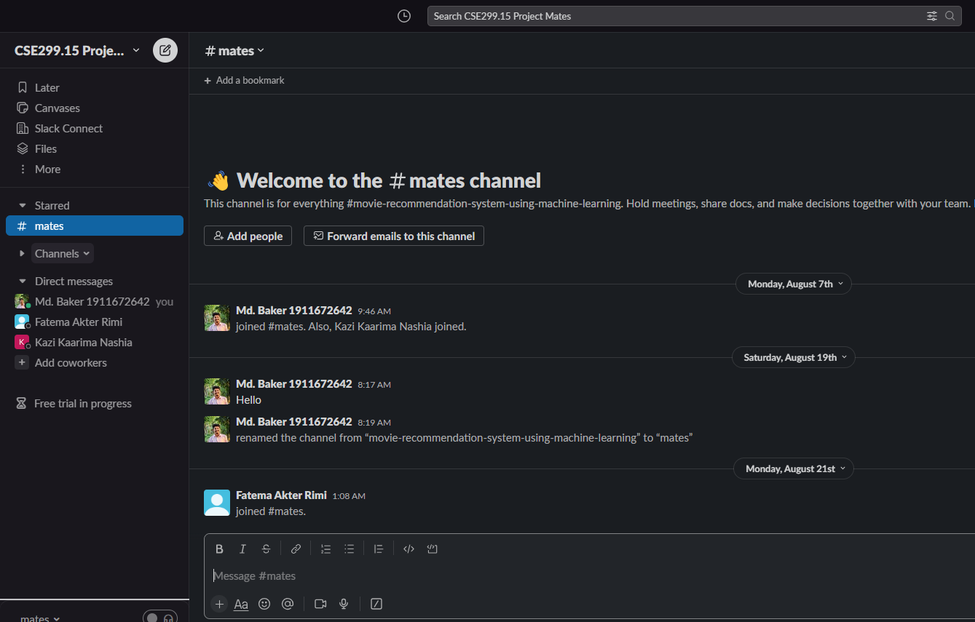
Slack:

Slide 11
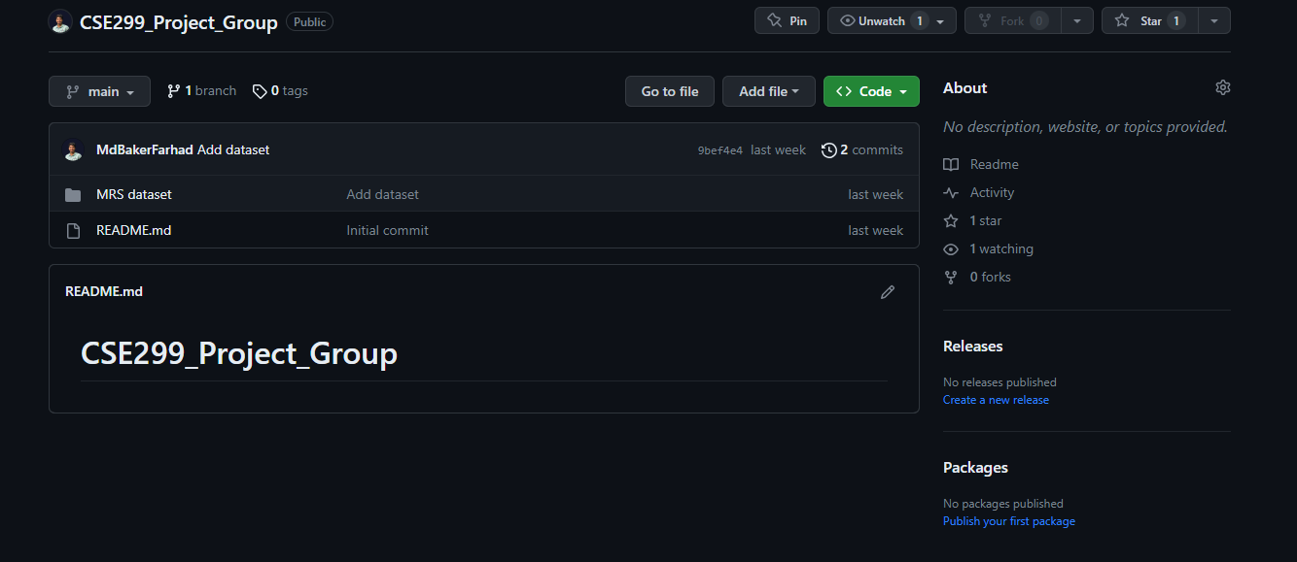
Github : https://github.com/MdBakerFarhad/CSE299_Project_Group

Slide 12
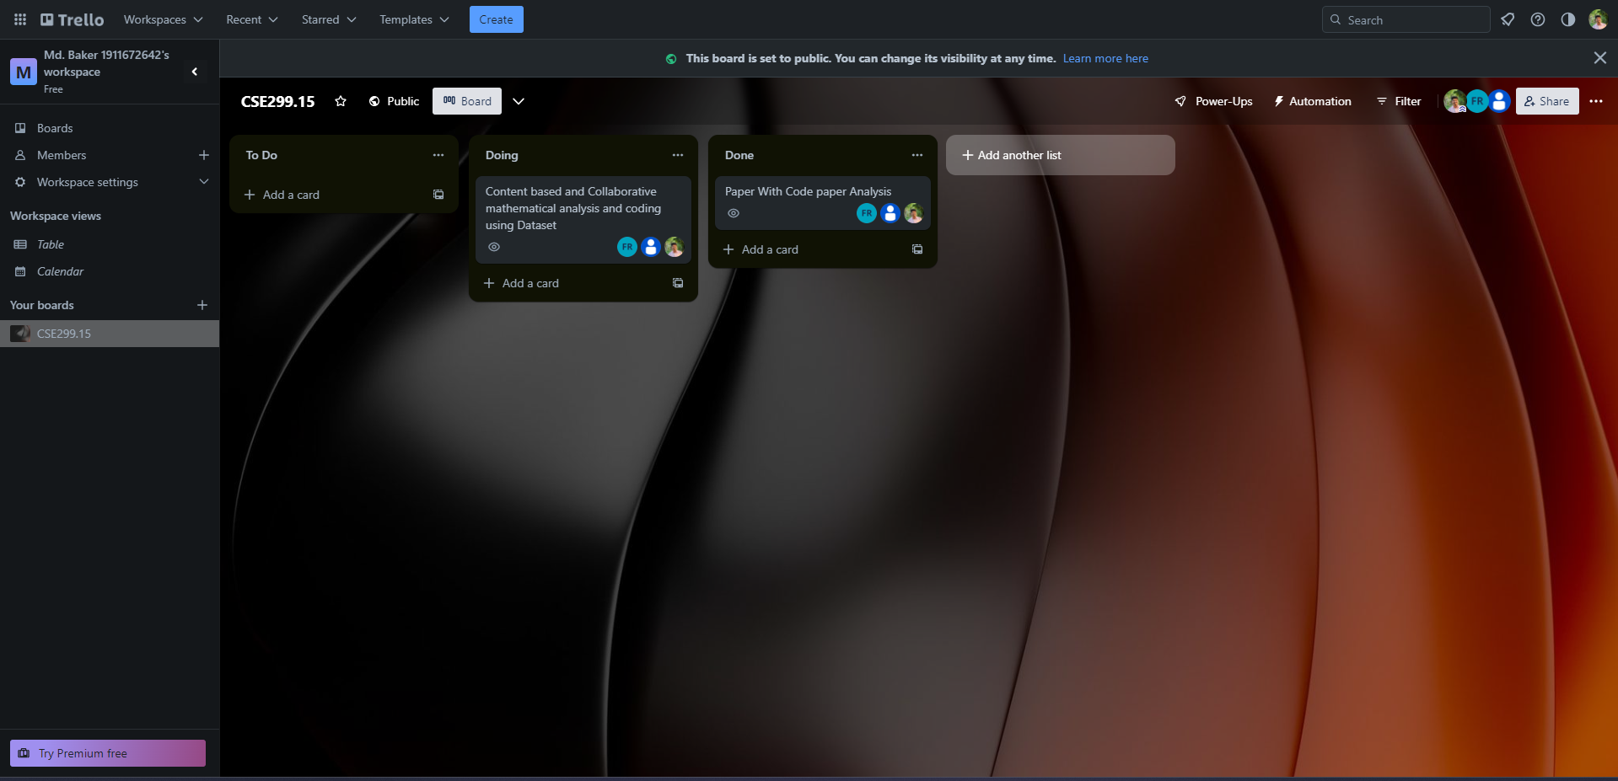
Trello Board: https://trello.com/b/aguWPOEO/cse29915

